Slide 1
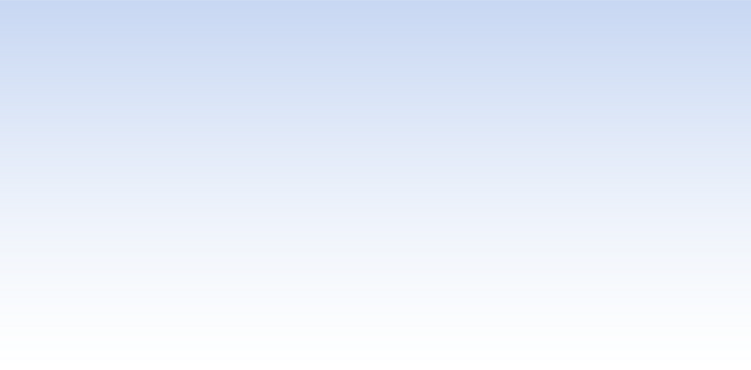


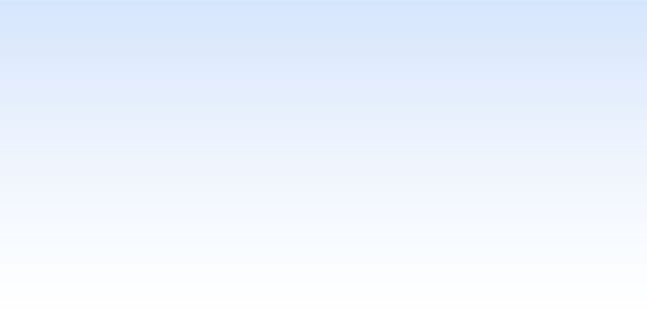

ATTENDANCE MANAGEMENT SYSTEM– CARMEY GIL CENTER
BAR SHIMON MALKA & OFIR SHAHAF
SUPERVISOR: DR. NAOMI UNKELOS SHPIGEL
8.9.2024
1
Notes:
Hello everyone, we are Bar Malka and Ofir Shahaf and our supervisor Dr. Naomi Unkelos Shpigel. Our project is an attendance management system for Carmey Gil Center. Before we start talking about the project, I want to tell you about Carmey Gil Center.

Slide 2


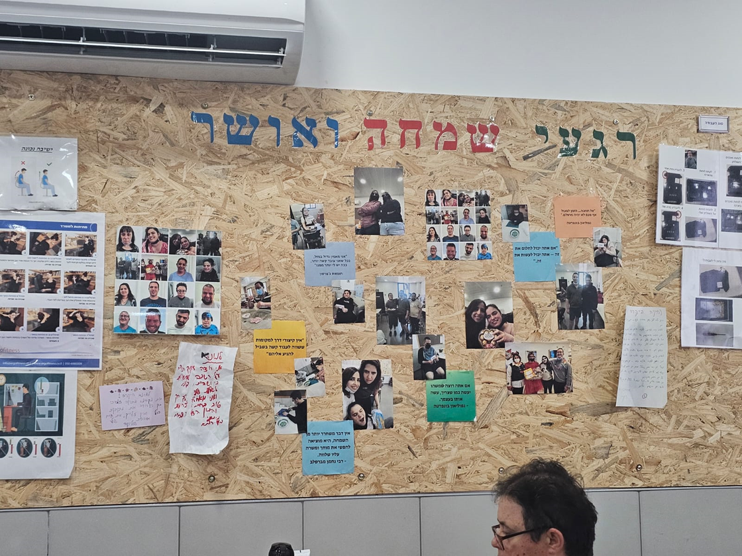
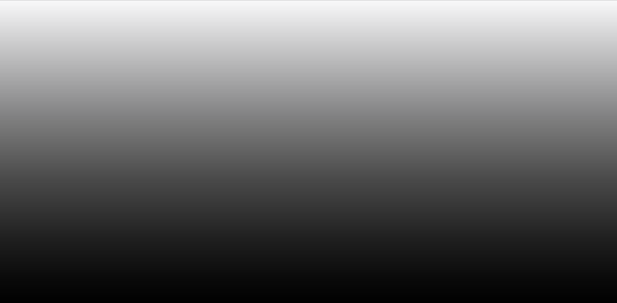
OVERVIEW OF CARMEY GIL CENTER
•Carmey Gil Center provides a supportive environment for individuals with intellectual or physical disabilities.
•Service recipients are grouped by ability levels, each with an instructor to guide daily tasks and activities.
•Service recipients arriving via various transportation at different times, the current manual attendance strains on the staff
2
Notes:
Carmey Gil Center is a place for people with intellectual and physical disability. The center allows them to meet other people with disabilities like them and spend time with them.
The people in the center are divided to groups according to their level of abilities. Each group has a guide who helps them with their daily tasks. Every day the people do work for factories in the area and at the end of the month they get a salary for the work.
The main difficult of the staff in Carmey Gil is tracking the attendance. Today attendance done manually and as a result makes tracking difficult.

Slide 3
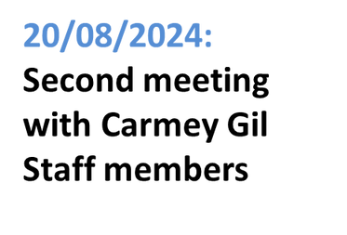

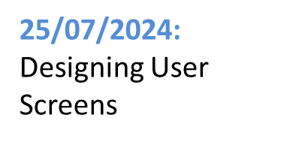
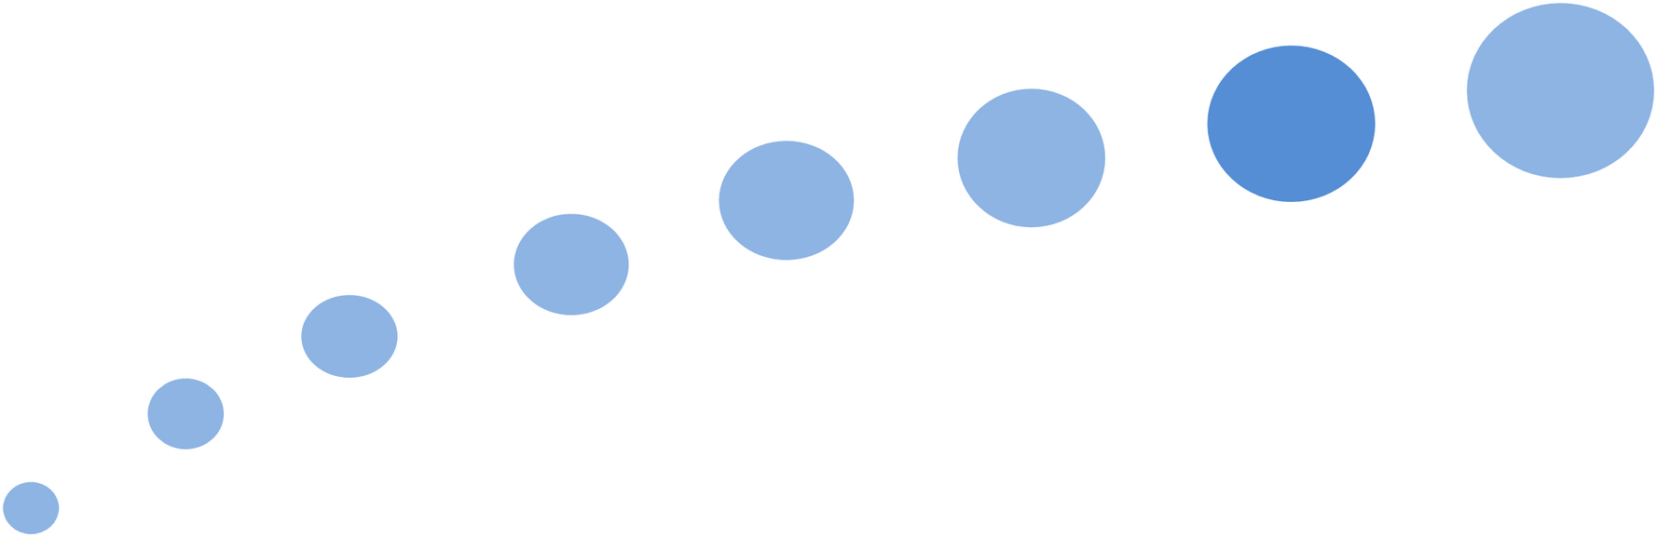
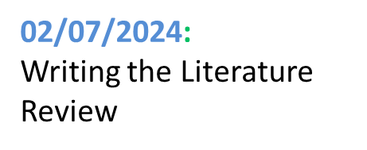
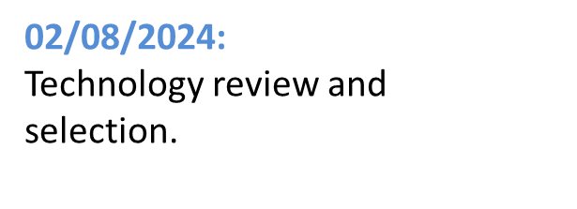
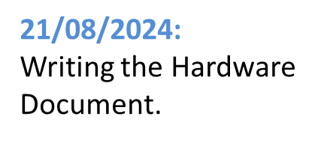
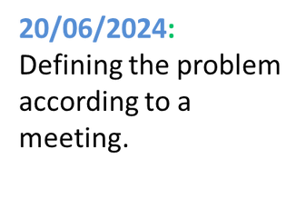
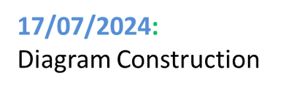
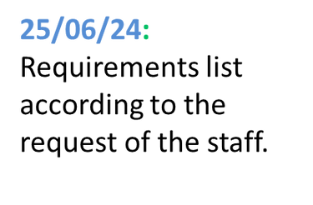

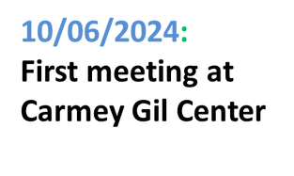
WORK PROCESS
3
Notes:
We started by visiting Carmey Gil Center, meeting the staff, and touring in place.
Next, we defined the main problem based on our meeting with the staff.
Then, we created a list of requirements based on what the staff needed.
After that, we did research to learn how to design the system for people with special needs.
We then made diagrams to show how the system will work.
Following that, we designed the system’s screens base on rooms design at Carmey Gil.
We also chose the best technologies and tools to build the system.
Later, we had a Zoom meeting with the staff to present our ideas and get their feedback.
Finally, we looked at different hardware options to make sure the system would work well at the center.

Slide 4

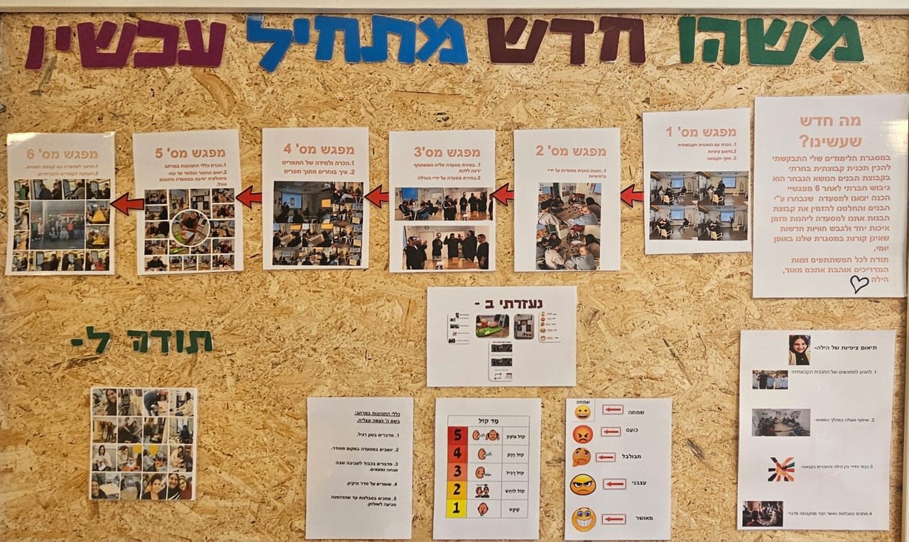
SUMMARY OF MEETINGS AT CARMEY GIL CENTER
First Meeting:
Identified the need for self-check-in and emotional tracking.
Decided on a visual-based interface due to low literacy levels.
Second Meeting:
Simplified service recipients login with pictures and emojis.
Emphasized the importance of fitting the system to the center’s setup and budget.
4
Notes:
To better understand and address the needs of the Carmey Gil Center, we held two meetings with their staff.
In our first meeting with staff, they highlighted the need to replace their manual attendance with a self-check-in system and suggested tracking emotional states.
We also noticed that many participants have low literacy levels, so we decided to focus on a image-based interface.
In our second meeting, we adjusted our approach based on their feedback.
We simplified the login process and We realized it’s important to think about the center’s current setup and budget to make sure ׳ק we will be able to complete the project in the future."

Slide 5




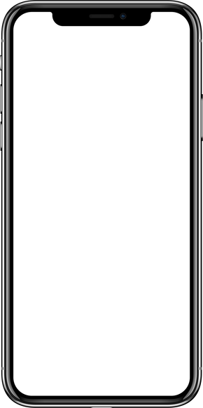

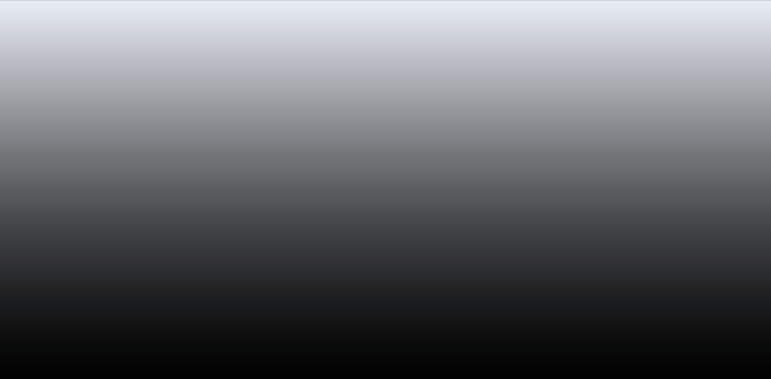


OPTIMAL ATTENDANCE MANAGEMENT SYSTEM
FREEING UP STAFF
QUICK ISSUE DETECTION
GENERATING DETAILED REPORTS
Automated attendance mark process free up staff for more important tasks.
The system identifies unusual behavior patterns promptly and alert to manager who can immediately handle it.
Detailed reports on attendance and emotional trends aid in better decision-making
5
Notes:
After we talked about the needs and the process, we can talk about our system.
Today a staff member waits at the entry of the center and marks everyone who arrives. Our system replaces the staff member and he can be freed for other tasks.
A system identify the emotional problems of the people and alerts the manager about it, so the staff can solve these problems immediately.
Reports generated in the system provide the staff important information about the mood and attendance. This way the system helps the staff to manage the people in a better way.

Slide 6
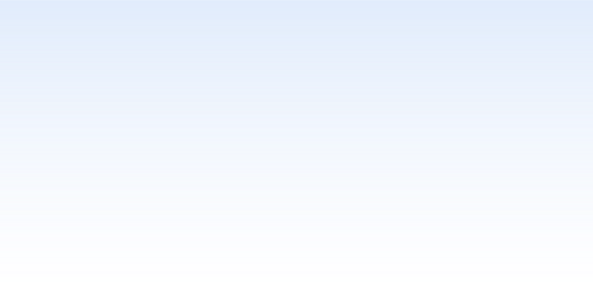

MAIN FUNCTIONAL REQUIREMENTS
Requirements | Number
The system shall identify service recipients . | 1
The System shall support alerts. | 2
The system shall support managing service recipients profiles | 3
The system shall support attendance marking. | 4
The system shall allow attendance tracking. | 5
The system shall support data-base. | 6
The system shall monitor the emotional state of users. | 7
The system shall support multiple languages. | 8
The system shall manage permissions for staff members. | 9
The system shall generate attendance reports. | 10
6

Slide 7

MAIN NON FUNCTIONAL REQUIREMENTS
Type | Requirements | Number
Usability | To ensure a user-friendly interface for people with special needs, we will follow relevant standards like ISO 9241-171, which offers guidelines for making software accessible to users with disabilities. | 1
Performance | After completing the attendance process, the system will be ready for the next user within two second at most. | 2
Scalability | The system will support up to 1000 users without any degradation in performance. | 3
Availability | The system will be available to perform operations at least 99% of the time each day. | 4
management | The system will allow manager to manage staff members roles and permissions. | 5
7
Notes:
Now we will continue with the non-functional requirements.
ISO 9241-171 is a standard that presents system instructions for people with special needs.
Next requirement The time that will pass between the end of the process until the system ready for using will be short.
Increasing the number of users will not affect on the work of the system.
We aim the system will available all the time.
The last allow better management of staff member.

Slide 8
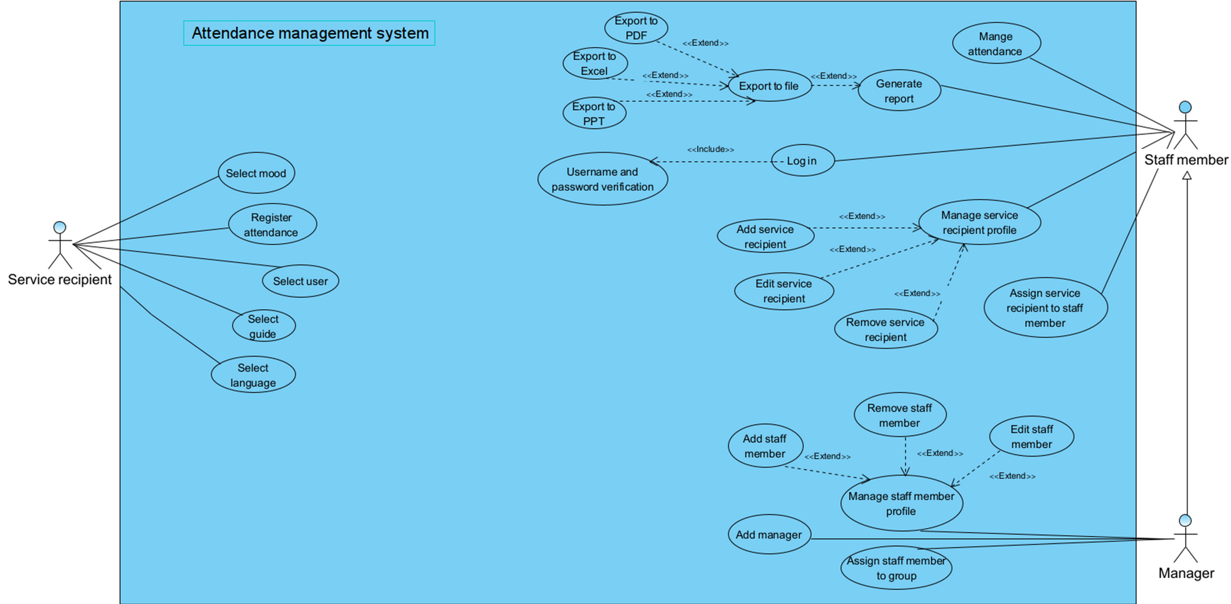
USE CASE DIAGRAM
8
Notes:
"Ok, thank you Ofir. I will continue now.
In this slide, I'm showing the Use Case diagram for our system.
This diagram helps us understand how different users will interact with the system.
Now, let's go over the main options available to each user in the system...
The 'Staff Member' is responsible for managing users in the system.
This includes adding, removing, and editing user profiles, generating reports, confirming attendance, and assigning users to guides.
The user's interaction with the system includes: select mood , ….
manager' has the ability to manage staff members, including editing their permissions.

Slide 9
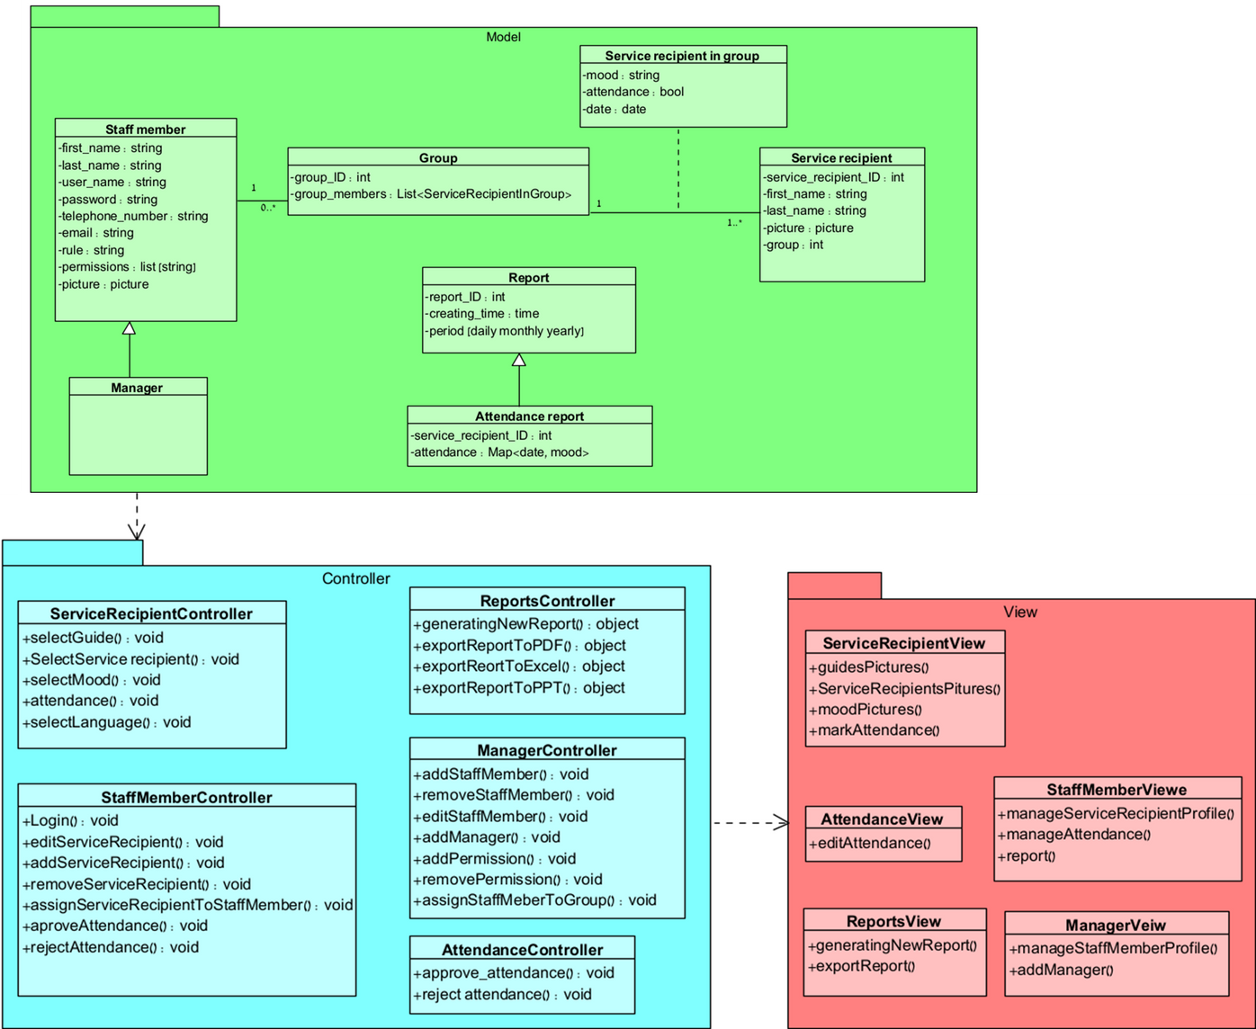
CLASS DIAGRAM
9
Notes:
"In this slide, we have the Class Diagram for our system.
This diagram represents the structure of the system by showing the classes, their attributes, methods, and the relationships between them.
Each class corresponds to a different part of the system.

Slide 10
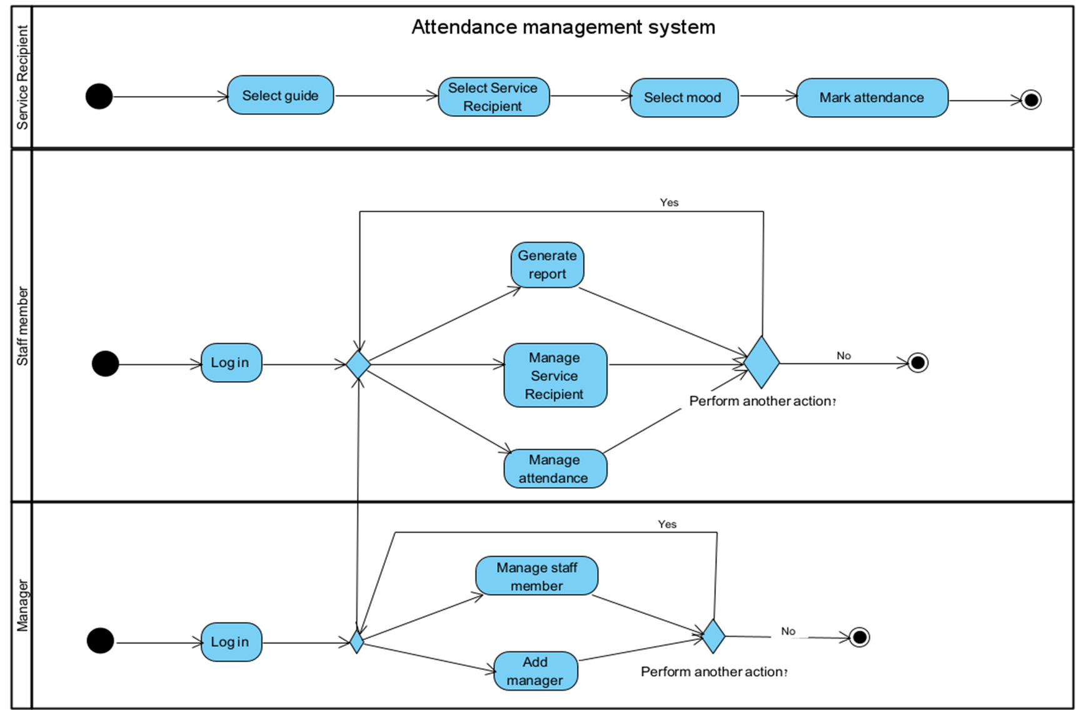
ACTIVITY DIAGRAM
10
Notes:
"In this slide, we have the Class Diagram for our system.
This diagram represents the structure of the system by showing the classes, their attributes, methods, and the relationships between them.
Each class corresponds to a different part of the system.

Slide 11
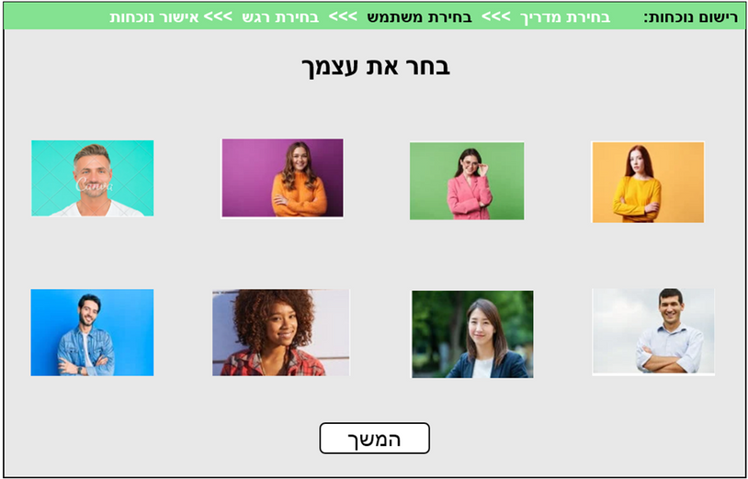
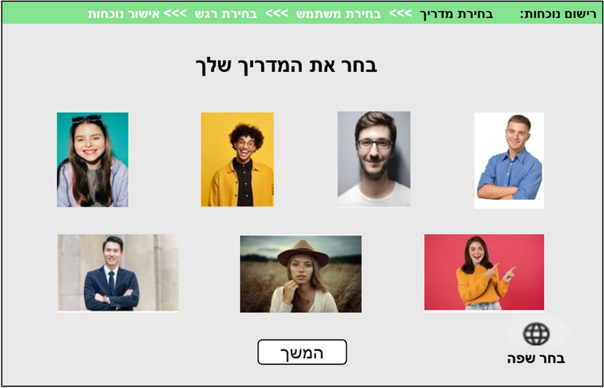
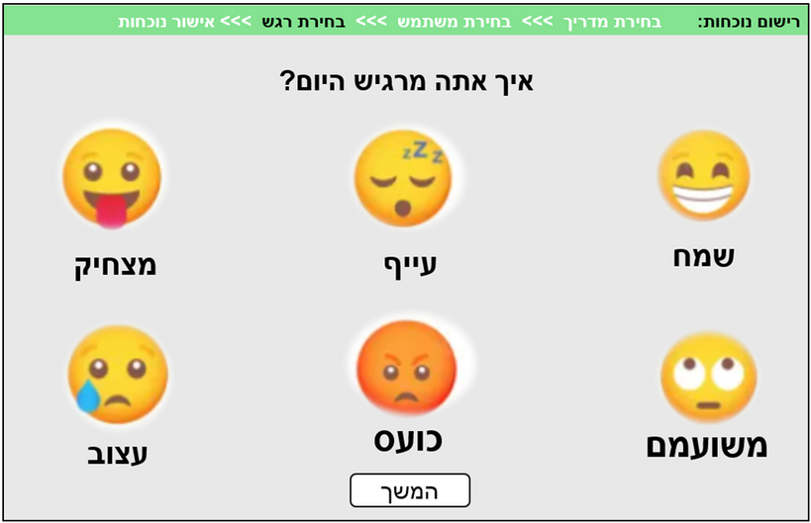
SERVICE RECIPIENT
SCREENS
11
Notes:
Ok, let's move on to example of the user screens.
As you can see, the 'User' starts by selecting the picture of their guide.
On this screen, they can also choose a different language.
Next, they select their own picture, and finally, they choose an emoji that represents how they feel today.

Slide 12
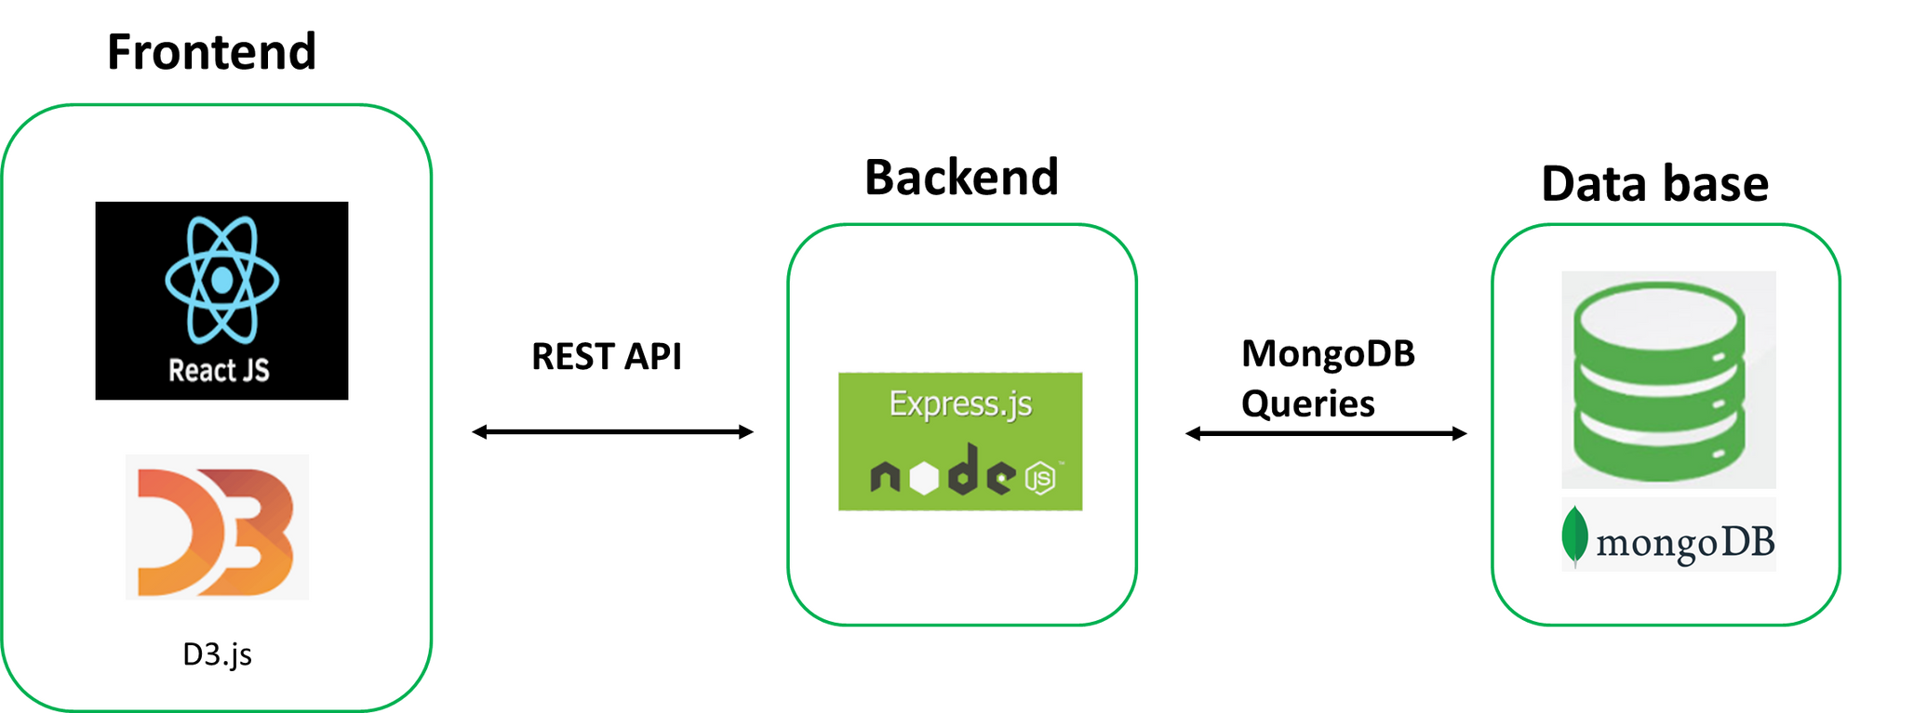
ARCHITECTURE
12
Notes:
In this slide, I will present the technologies we chose to implement our project and explain why we selected each of them
React JS: We selected React JS for our system's frontend because it's great for making dynamic and responsive interfaces.
It helps us create a user-friendly design that works well on different devices, like touch-screen TVs.
This is important because it meets the needs of all users at the center.
.
Node.js and Express.js: For the backend, we chose Node.js with Express.js because they handle multiple tasks efficiently, ensuring smooth and real-time processing of attendance and emotional data.
MongoDB: We selected MongoDB as our database because it's flexible and fast, perfect for storing and managing the data types we need.
D3.js : Lastly, we will use D3.js for data visualization, which will help us to create clear and interactive reports for the stuff members.
OK, now let's move on to the architecture of our system.
As you can see, there's a two-way communication between the Frontend and the Backend, , which is handled using REST API
The Backend also has a two-way connection with the Reporting and Analysis, where reports are generated. This connection ensures that the necessary data is sent and received efficiently.
Additionally, there's a two-way communication between the Backend and MongoDB, which is managed using MongoDB queries. This allows the Backend to store and retrieve data as needed.

Slide 13

PROJECT GOALS
Independent staff Use
Build a system that staff can manage without assistance, despite limited tech skills.
Deadlines and testing
Complete the project a two month before the deadline for testing and smooth integration.
Device optimization
Ensure the system works across various devices like iPads and phones .
13
Notes:
1. Ensuring Staff Can Use the System Independently
One of the biggest challenges will be building a system that the staff can manage on their own in the future, without needing our help. Given their limited knowledge of technology.
2. Meeting Deadlines and Allowing Time for Testing
Another challenge is that we want to finish the project at least one month before the final deadline. This will give us enough time to do thorough testing and make sure the integration goes smoothly.
3. Optimizing for Different Devices
Another challenge will be making sure the system works well on different devices, like iPad, phones .

Slide 14



SUCCESS CRITERIA
USER ADOPTION
ACCURACY
RELIABILITY
Achieve 85% independent usage of the system by service recipients and staff at the Carmey Gil Center within the first month.
The system should log attendance and emotional states with at least 95% accuracy.
Ensure stable operation under continuous internet connectivity, aiming for 99% uptime with no major interruptions.
14
Notes:
During the first month of implementing the system we are going to perform a System Usability Scale to get feedback for the use of the system. In this month we will observe about the service recipients using in the system and pay attention about their difficult in the process in goal to solve theme. In addition to performing the attendance process in the system, the staff member continue will mark attendance manually including the selected emotion.
We aim that 85% of the users use the system without help. we follow about they problems and solve theme.
We aim that the accuracy of the system is at least 95%, meaning the information in the system match to information in manually log of staff member.
in order to achieving 99% uptime, during testing we will check the system runs smoothly without major interruptions. Any problem will be resolved immediately to ensure reliability.

Slide 15

MAIN TESTING CASE
Staff member and manager Login.
Marking attendance process.
Service recipients management.
Staff member management.
Report generate.
Alert
15

Slide 16


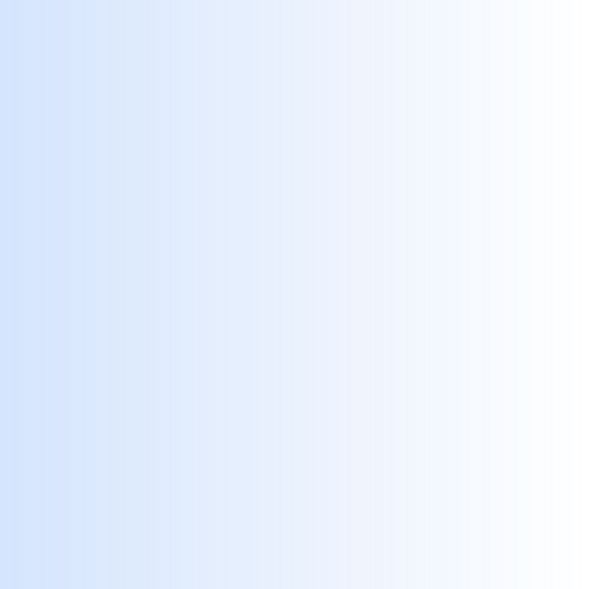
THANK YOU FOR
!LISTENING
16
Notes:
Now we will love to answer questions

